Slide 1
TOPIC
Configure an EC2 instance and access instance using RDP

Slide 2
OBJECTIVES
To Configure and deploy a windows Elastic Compute Cloud (EC2) using Amazon Machine Image(AMI) and remotely access the instance using Remote Desktop Protocol (RDP).
To identify the importance of AWS EC2 in organizational projects and security applications.

Slide 3
AWS EC2 INSTANCE
An Amazon EC2 instance is a virtual server in Amazon's Elastic Compute Cloud (EC2) for running applications on the Amazon Web Services (AWS) infrastructure.
Instances are created from Amazon Machine Images (AMI). The machine images are like templates. They are configured with an operating system (OS) and other compute resources such as memory(CPU). Storage type(HDD,SSD), Network etc , to suite the users demand or need.

Slide 4
AMAZON EC2
Amazon EC2 provides cloud hosted virtual machines, called "instances", to run applications.
Amazon EC2 provides scalable computing capacity in the AWS cloud. Leveraging it enables organizations to develop and deploy applications faster, without needing to invest in hardware upfront. Users can launch virtual servers, configure security and networking, and manage cookies from an intuitive dashboard.

Slide 5
WHY IS AWS EC2 IMPORTANT
You don’t require any hardware units
Easily scalable (up or down)
You only pay for what you use
You have complete control.
Highly secure.
You can access your assets from anywhere in the world.

Slide 6
REMOTE DESKTOP PROTOCOL (RDP)
The Remote Desktop Protocol (RDP) is one of the main protocols used for remote desktop sessions, which is used to access office desktop computers from another device.
RDP allows you to remotely connect to another computer over a network, giving you full access to and control over the computer's software, data and resources. You can use RDP for a variety of reasons, including screen sharing, remote collaboration, monitoring and troubleshooting.

Slide 7
HOW TO CREATE AN INSTANCE
Open an AWS console
Go to search column, type EC2 and Enter
Click on Launch instances
Choose an instance name, create a key pair
Enter a key pair name. Choose a private key file format, then click create.
Allow RDP traffic from anywhere
NOTE: This will help you connect to your instance.
Click on create instances.
Go back to instances, click on the instance you created and connect.
Go to RDP client
Click on Get password, browse to download key pair browse and decrypt.
Click on Remote Desktop Connection , paste the password that was decrypted and click ok.
On remote Desktop Connect, click Yes
The server will be launched.

Slide 8
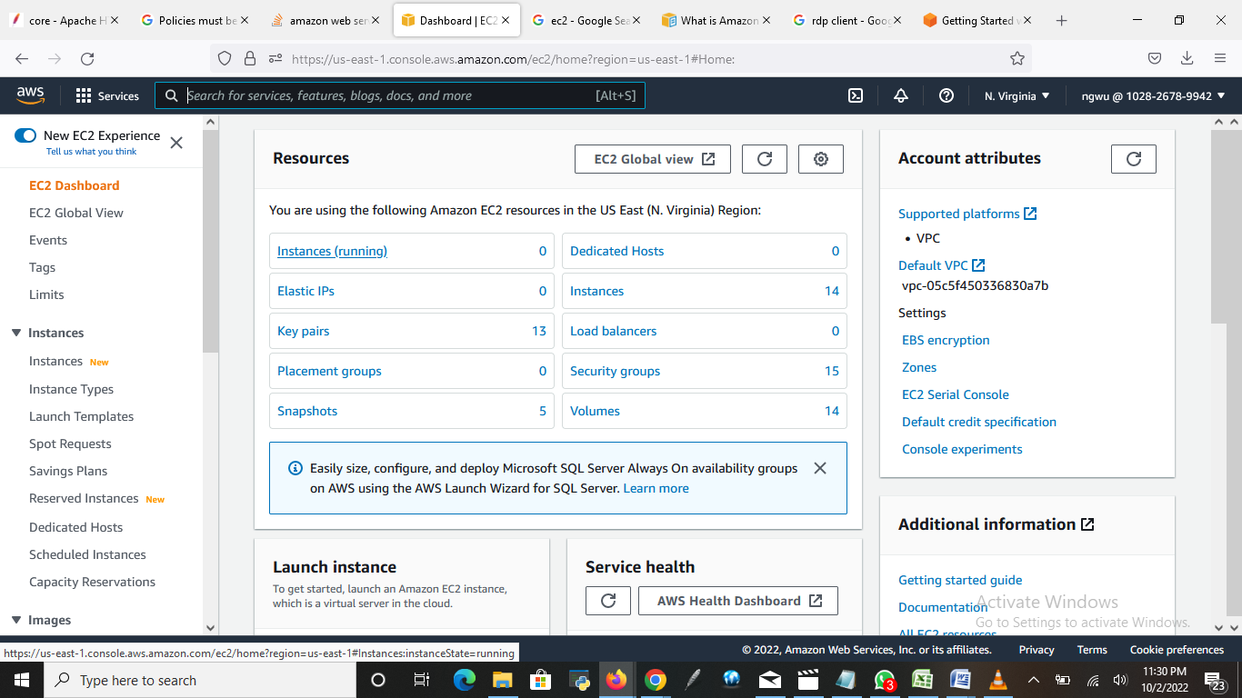
START THE PROCESS WITH SCREENSHOT

Slide 9
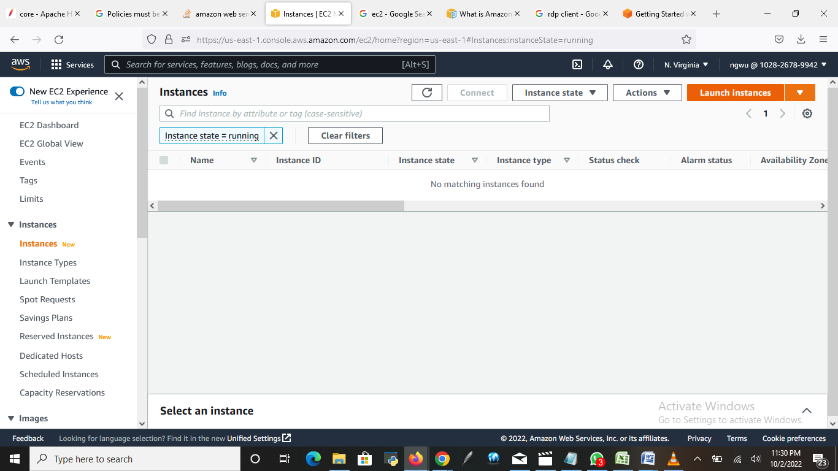
Open an EC2 dashboard, click on instances. Click on Launch instances

Slide 10
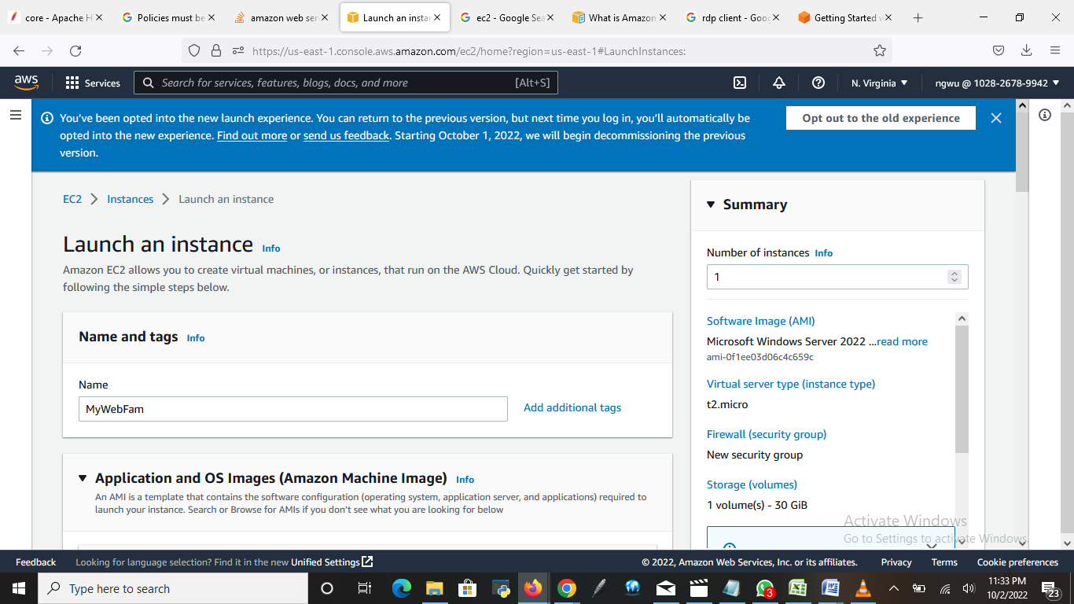
Enter the name of the server. Eg “MyWebFam”

Slide 11
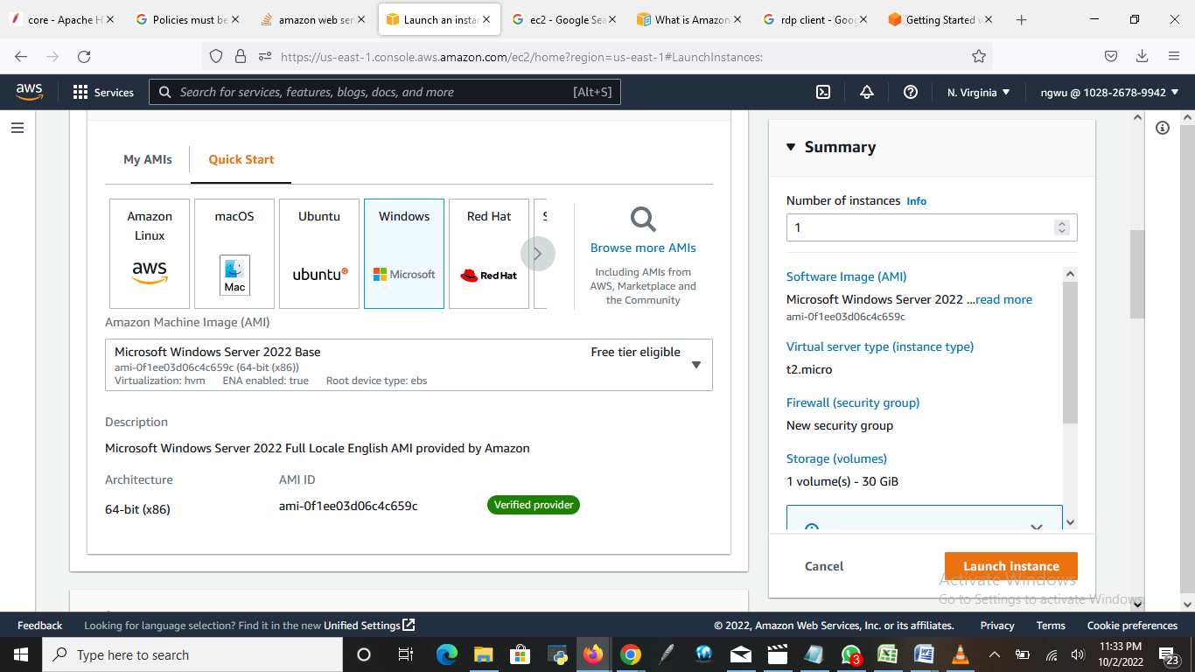
Under “Quick Start” choose Windows

Slide 12
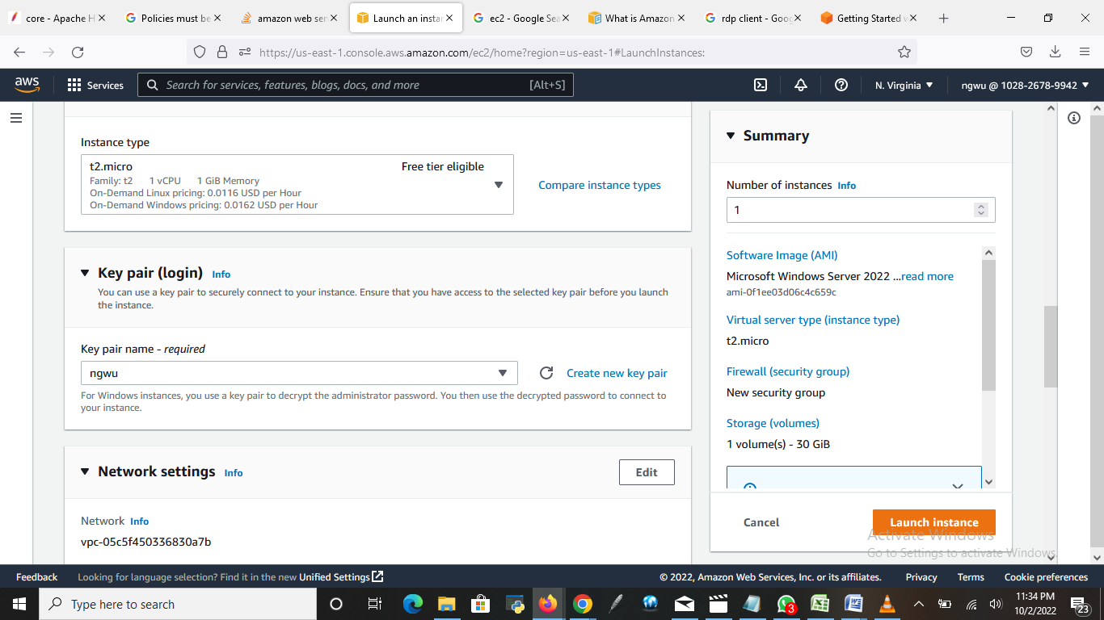
Create new key pair

Slide 13
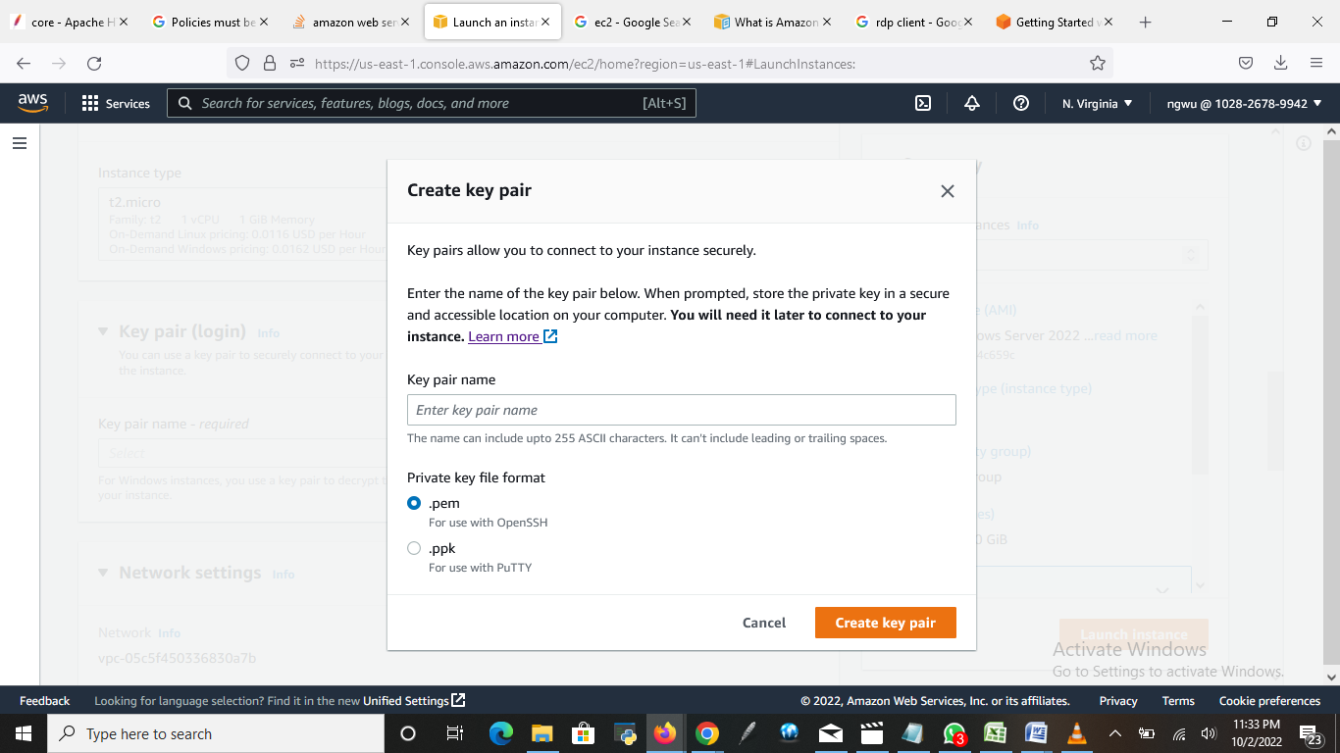
Create a key pair by entering a key pair name. Eg: ngwu, then click on create

Slide 14
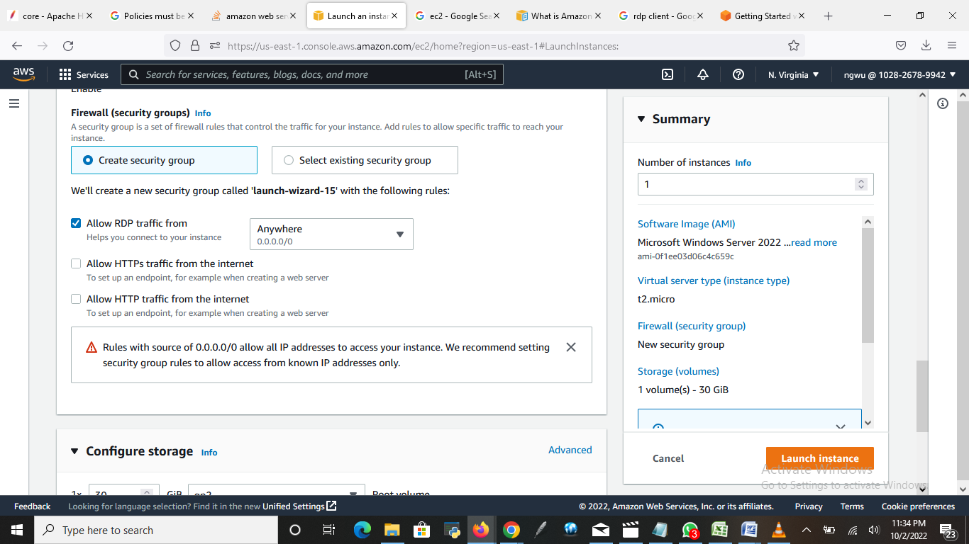
Allow RDP traffic from “Anywhere”

Slide 15
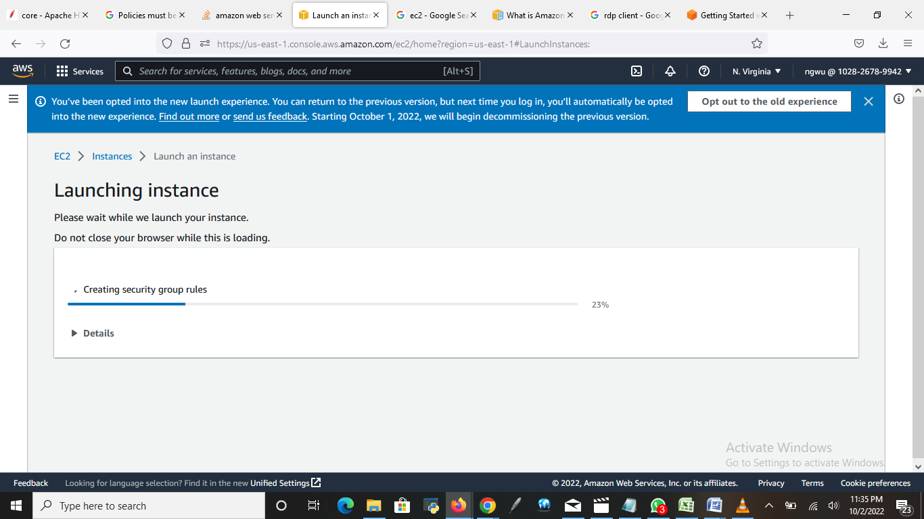
Click on Launch instances.

Slide 16
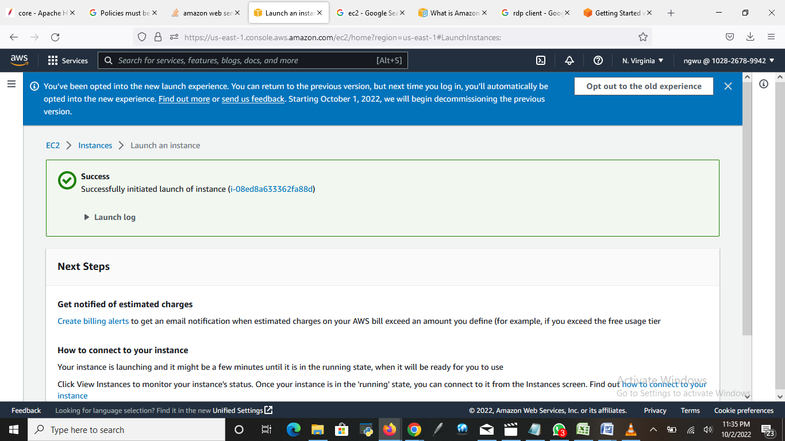
The instance has successfully launched.

Slide 17
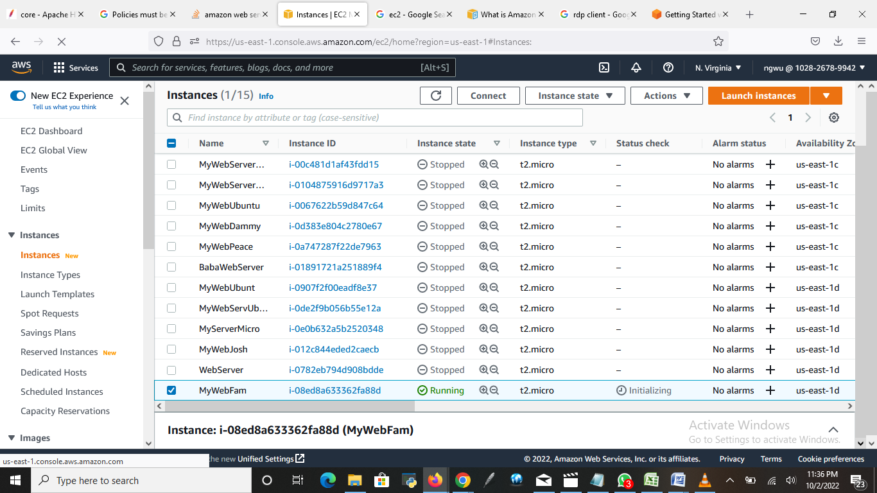
Go to instance you created, select it and click “connect”

Slide 18
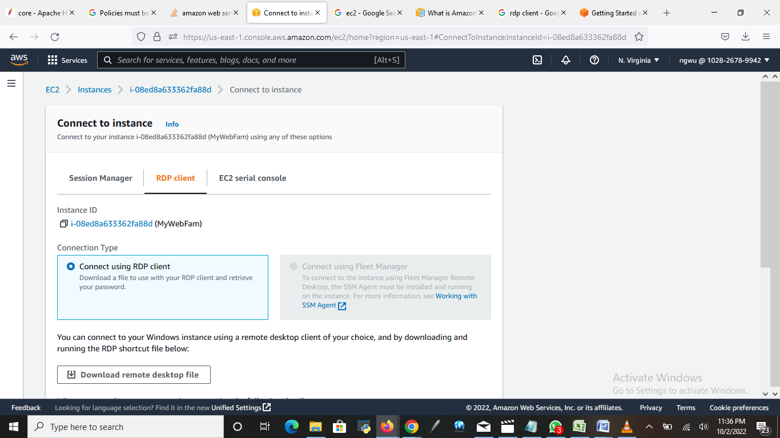
Go to RDP client, choose “connect using RDP client”

Slide 19
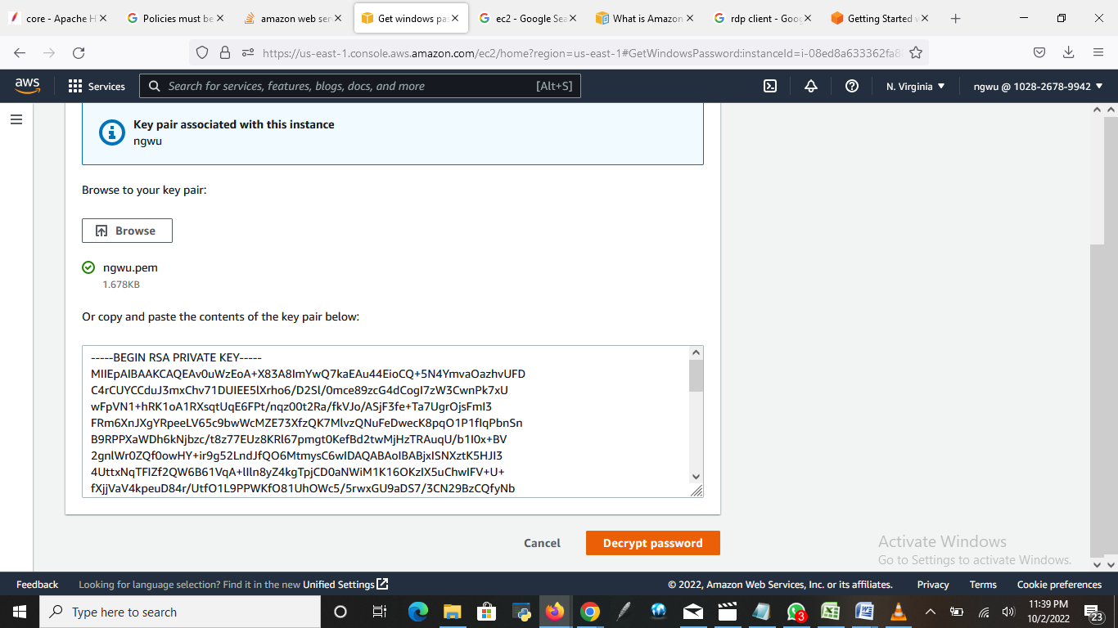
Click on “Browse” to get the key pair you created to decrypt the password, and then click on “Decrypt password”

Slide 20
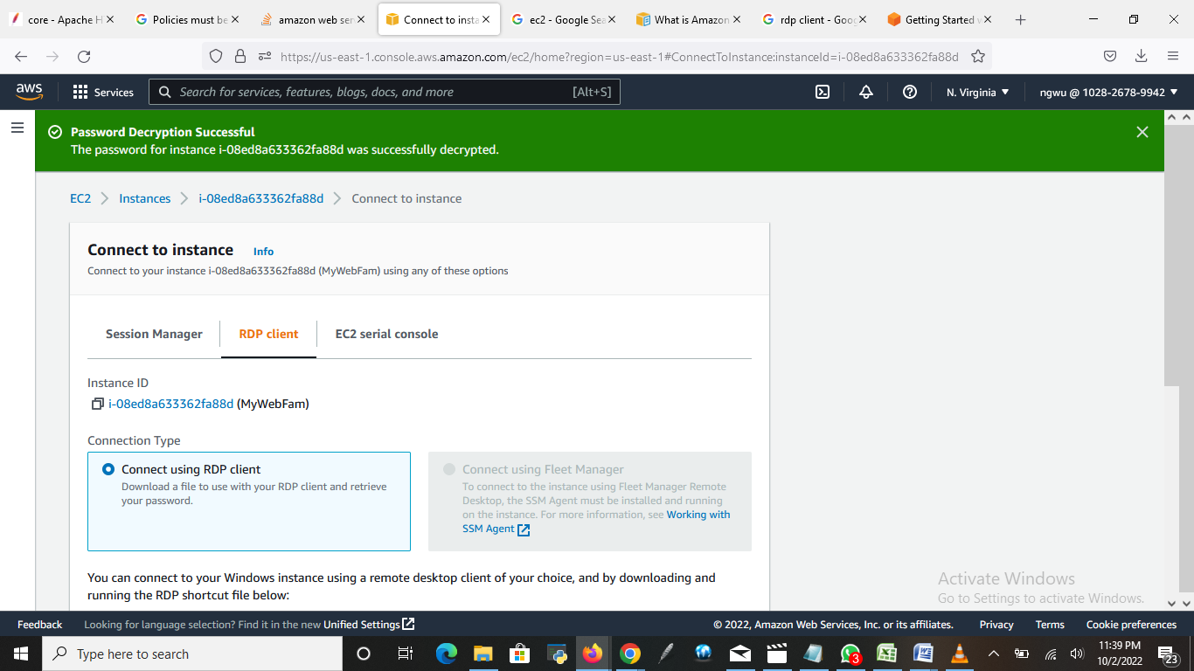
You will see “Password Decryption Successful”

Slide 21
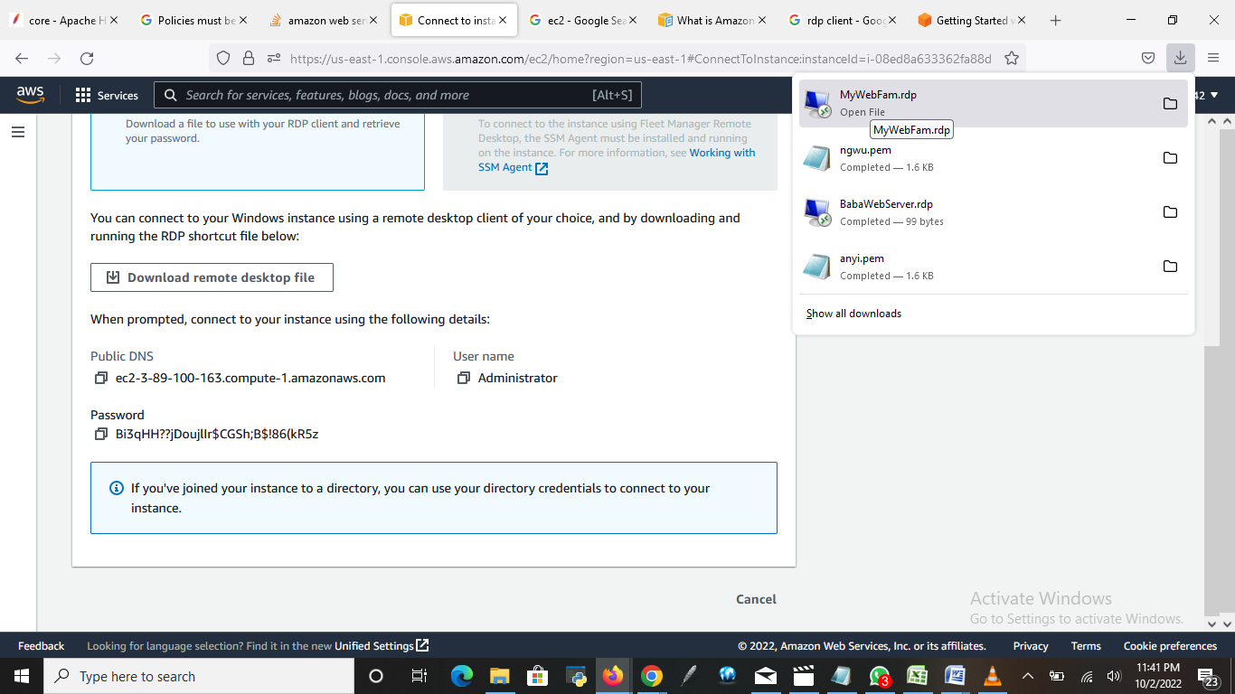
Click on “Download remote desktop file”. At the top right side, you will see the web name “MyWebName.rdp” click on it.

Slide 22
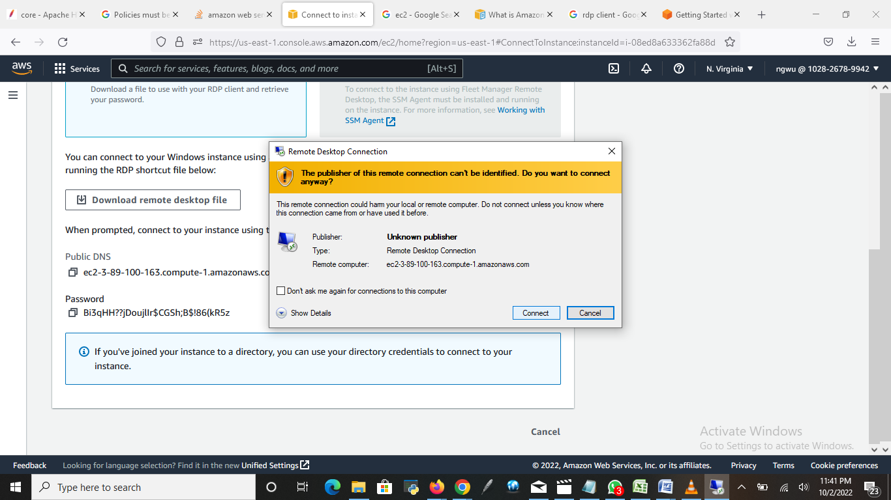
Click on Connect

Slide 23
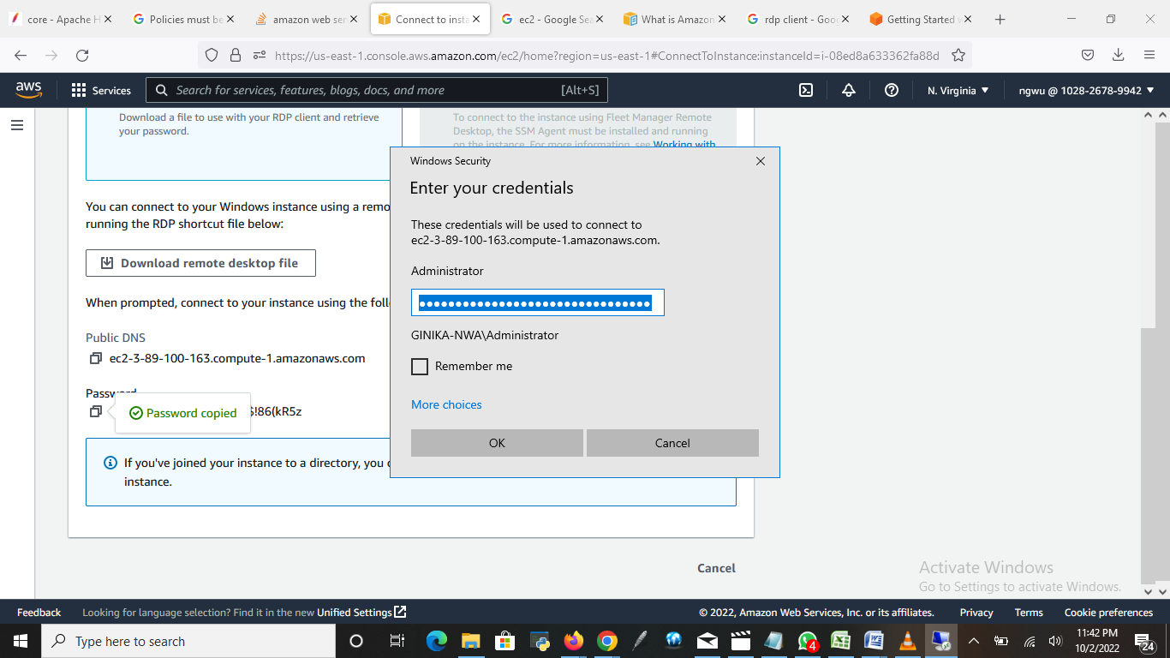
Enter the password you decrypted and click “ok”

Slide 24
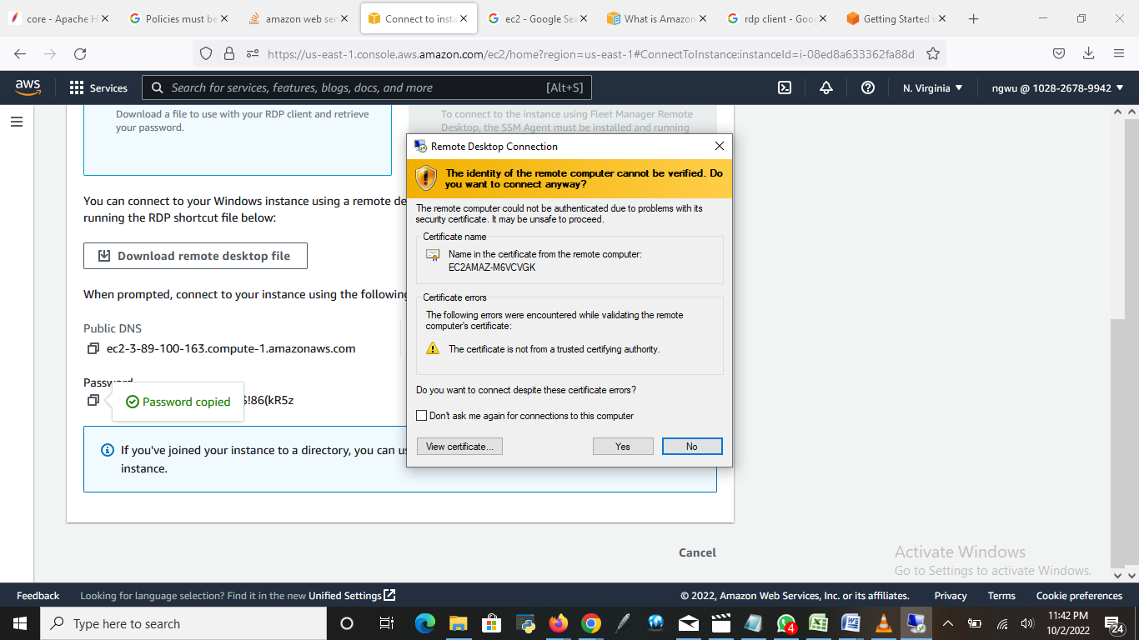
Click “Yes”

Slide 25
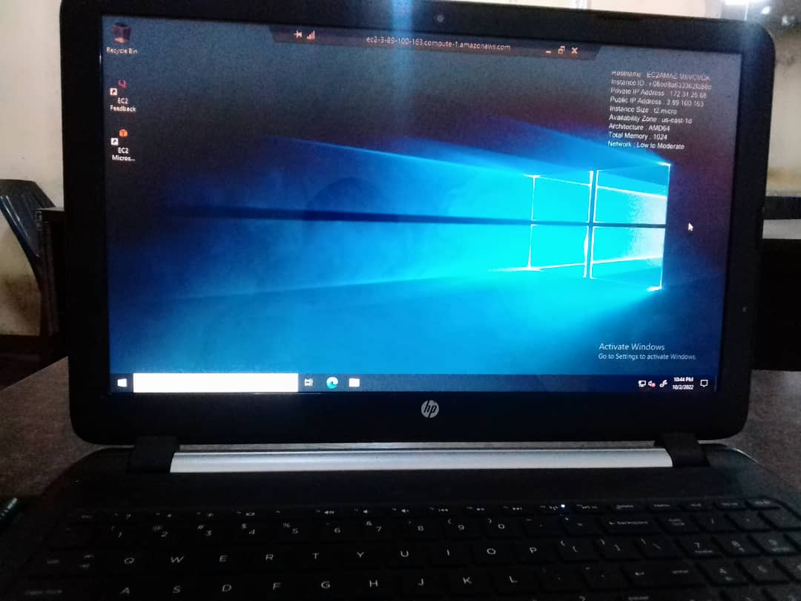
Instance successfully launched using RDP client.

Slide 26
CHALLENGES
One of the challenges encountered in the course of this project work was the occasional “ session connection timed out" issue due to long running processes.
We also experienced some login failure. This because we initially did not configure the Internet Protocol (IP) address to accept traffic from anywhere.
Our generated user key was also at a point not recognized by the server.

Slide 27
AWS EC2 SECURITY BEST PRACTICES FOR ORGANIZATIONS
Configure security groups to control traffic to your EC2 instances. These groups act as a firewall for your EC2 instances, controlling traffic both to and from your instances.
Use key pairs to encrypt traffic to and from your EC2 instances. By using a key pair, only authorized users can access your instance.
Use Identity and Access Management policy and roles to give access to your EC2 instances.
Use Amazon Inspector to assess the security of your EC2 instances.

Slide 28
CONCLUSION
Amazon EC2 helps to launch as many or as few virtual servers as you need, configure security groups, networking, and manage storage.
Amazon EC2 enables you to scale up or down to handle changes in spikes due to increased traffic, and reducing your need to forecast traffic.
It also make Cloud Computing Easier With Online Cloud Server Providers At Affordable Prices

Slide 29
REFERENCES
What is Amazon EC2. Retrieved from https://docs.aws.amazon.com/AWSEC2/latest/UserGuide/concepts.html
What are the security risks of RDP? | RDP vulnerabilities. Retrieved from https://www.cloudflare.com/learning/access-management/rdp-security-risks/
AWS EC2 Best Practices. Retrieved from https://medium.com/@cloud_tips/aws-ec2-security-best-practices-c06f94059f12
Managing AWS EC2 Instances. Retrieved from https://www.pluralsight.com/courses/aws-managing-ec2-instances?aid=7010a000002LUv2AAG&promo=&utm_source=non_branded&utm_medium=digital_paid_search_google&utm_campaign=XYZ_EMEA_Dynamic&utm_content=&cq_cmp=1576650371&gclid=Cj0KCQjwnP-ZBhDiARIsAH3FSRfnCqcDt7Y6b0Ini-6mo8mMP-nxxQgIb65sbhWdwy4FDRyY1KAXZw4aAk-WEALw_wcB
Amazon EC2 instance. Retrieved from https://www.google.com/amp/s/www.techtarget.com/searchaws/definition/Amazon-EC2-instances%3famp=1

